Slide 1

Airline Safety and Awesome Travels
By Daniel Carbajal

Slide 2
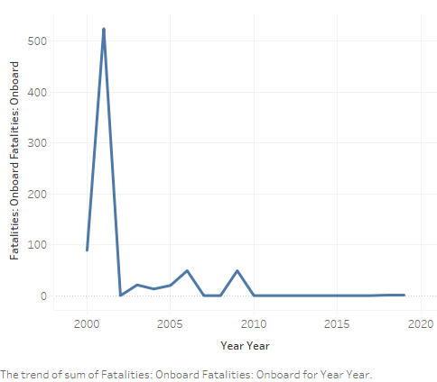
Airline Is Safer Than Ever
Reports have come in that there are a lot more airline accidents than usual
This is not the case
As seen on the graph airline has one of the safest records since 2000

Slide 3
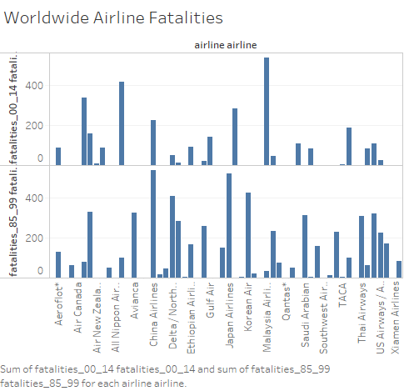
Air Travel Around the World
The Airways are safer in the past 15 years
See a comparison of the last 30 years
Overall airline safety is good

Slide 4
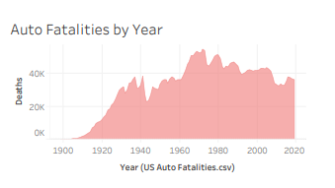
Airline Travel vs driving
While Airline Safety has increased Traffic Safety has not
It still numbers in 30,000 plus fatalities per year in the last 15 years
Overall driving has not improved since the beginning

Slide 5
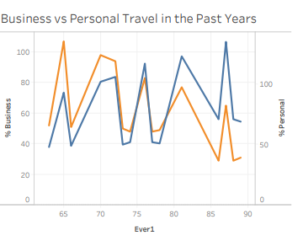
AirLIne Travel for Leisure is increasing
Business Travel has been decreasing
However Leisure Travel is increasing
Leisure Travel includes families and couples
Business Travel usually only includes one person
Potential for higher revenues

Slide 6
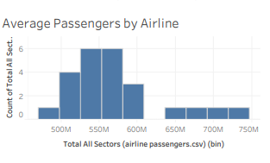
Passengers counts have increased
Overall Passengers have increase
More potential for full flights
This Means
Better Revenue
Great safety in reliable transportation

Slide 7
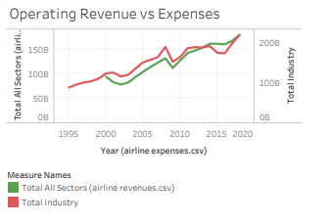
Overall The revenue stream is increasing
Operating Revenue increasing
Keeping Expenses at bay
Potentially to grow revenue more since more volume of passengers is flying

Slide 8

Very safe and fun to travel
This is a period where airlines are having the best safety
Great technology to keep airplanes safer
Revenue is growing
Number of passengers increasing due to leisure travel
Overall still faster and safer than driving to your destination

Slide 9
Questions?

